Slide 1


Robotics Workshop Week 4 More Input
Notes:
Hello everyone and welcome to the 4th robotics workshop.
Last week we looked at gears and mechanical motion and today we’re going back to electronics to introduce some analogue input devices.
In addition to this, teaching a new method for controlling many pins at once on the Pi Pico.
f this is your first time using the Pi Pico’s, I would recommend going through the first worksheet before starting this one.

Slide 2
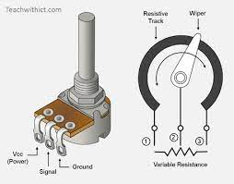
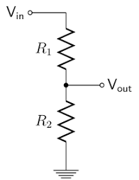
What is a potentiometer
Potentiometer Inside
Voltage divider
Total resistance:
2000Ω + 1000Ω = 3000Ω
1000Ω/3000Ω = 1/3
1/3 * 5V = 1.67
Voltage is split evenly across resistance so between voltage out and ground there will be 1/3 of the voltage and hence 1.67V
5V
1.67V
0V
2kΩ
1kΩ
Notes:
The first device you’ll be learning about is called a potentiometer, it has 3 pins, one for ground, one for power and one for output, when you manually spin the nob you vary the electrical potential aka voltage on the output pin between the power and ground voltage levels.
This works like a voltage divider where voltage is split between 2 resistors. Now, what is a voltage divider?
It is simply a configuration of two resistors in series where you take the middle of those two resistors as an output. Depending on the resistance in Ohms of each resistor you get a different voltage output.
For example, if you had 2Kohm and 1Kohm resistors in this voltage divider the voltage would get split evenly across the resistance so 1/3 of the voltage will be between V out and ground giving an output of 1.67V
In a potentiometer when you rotate the nob, these resistance values change and hence the ration of voltage changes giving a variable output.

Slide 3
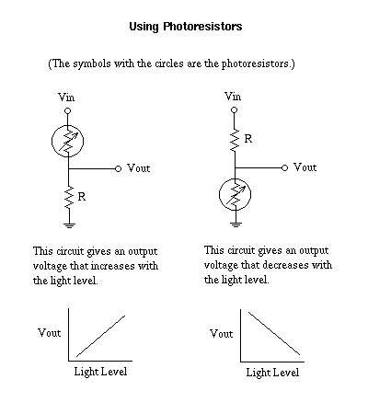
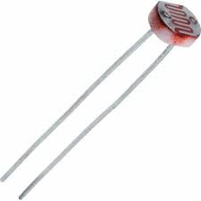
What is a Photo-resistor
Notes:
Now, photo-resistors vary their resistance based on light level and can be used as apart of a voltage divider to produce a variable voltage output.
This voltage output can be read by the Pi Pico's Analogue to Digital Converter, ADC for short and read as a digital value.
Now you have one more new device today, a simple buzzer, it’s a small black cylinder in each kit and you can mess around with it when finishing the worksheet. Just keep in mind that it does have a positive and negative, where the positive pin is the slightly longer one.
Again if you didn’t do the first worksheet I would recommend doing it it before this one to fully understand the basics, so lets get started.

